Slide 1
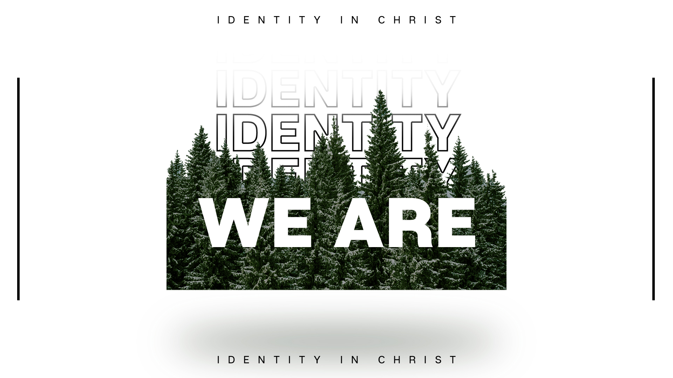

Slide 2


Slide 3

II Corinthians 5:11-21
We have come to know the “fear of the Lord”
We are controlled by the “love of Christ”
These changes are effectual in us..
  We are a new creation, with new vision…
  We have received reconciliation
  We have received a ministry

Slide 4
Ambassadors for Christ
A person acting as representative or promotor of an activity, person, or cause…
We are channels for God’s reconciliation
Parakaleo – make an appeal or comfort
Deomai – beg, implore, plead
Nothing is “off the record”

Slide 5
…so that we might become the righteousness of God…
Romans 8:3 “…sending His own Son in the likeness of sinful flesh and as an offering for sin…”
Leviticus 16:21-22 “…shall bear on itself all their iniquities…”
Romans 3:26 God is both “just and the justifier”

Slide 6
…so that we might become the righteousness of God…
Revelation 1:5 “first born from the DEAD…”
Revelation 5:6 a Lamb standing, as if SLAIN…
Revelation 5:12 Worthy is the Lamb that was SLAIN…
Revelation 13:8 the Lamb who has been SLAIN…
Revelation 19:11-13 the righteous judge who is clothed in a robe dipped in BLOOD…

