Slide 1
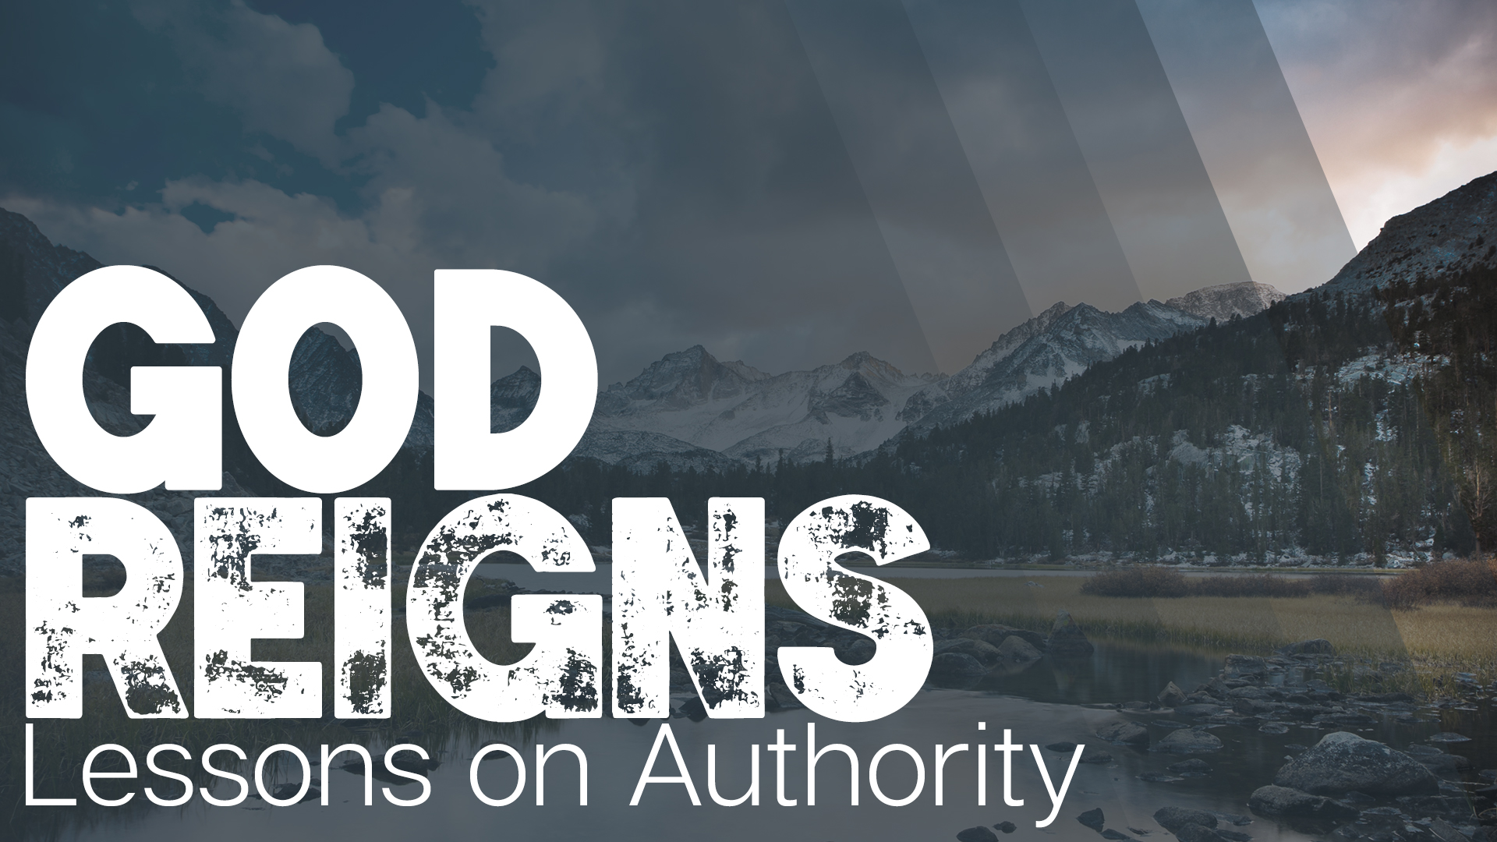

Slide 2

Evaluating Traditions
What is a tradition?
  A belief or custom which is passed down
The word of God is not MERELY a tradition.
  II Peter 1:19-21 “So we have the prophetic word made more sure, to which you do well to pay attention as to a lamp shining in a dark place, until the day dawns and the morning star arises in your hearts. But know this first of all, that no prophecy of Scripture is a matter of one’s own interpretation, for no prophecy was ever made by an act of human will, but men moved by the Holy Spirit spoke from God.”

Slide 3
Evaluating Traditions
3 TYPES OF TRADITIONS
Traditions of ERROR
  Views and beliefs which stand opposed to God’s word.
Traditions of TRUTH
  Views and beliefs which are necessitated in God’s word.
Tradition of CHOICE
  Views and beliefs which are NOT necessitated in God’s word but also NOT opposed to it.

Slide 4
Evaluating Traditions
3 QUESTIONS WE MIGHT ASK
Is it OLD? (Acts 17:1-9)
  The Thessalonian Jews rejected anything that challenged their traditional views.
Is it NEW? (Acts 17:16-34)
  The Athenians desire for NEW things proved incapable of changing their hearts
Is it TRUE? (Acts 17:10-15)
  The Bereans were commended for the NOBLE desire to search God’s Word

Slide 5
Evaluating Traditions
3 THOUGHTS ON CHANGING TRADITIONS
There is danger in changing traditions because we are BORED!
There is danger in refusing to change because we are PROUD!
There is WISDOM in pursuing what God has authorized for the benefit of the congregation!

