Slide 2
RECOGNIZING THE BATTLE IN EPHESUS
Acts 20:17-38 Paul warns the elders a battle is coming!
Ephesian Letter – Paul warns the church the battle is coming!
I Timothy – Paul challenges the evangelist to keep fighting the battle.
Revelation 2:1-7 – Jesus admonishes the church on how they have FOUGHT the battle.

Slide 3
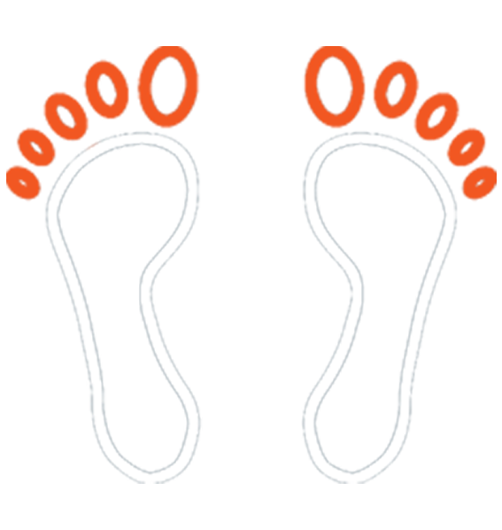
HOW DO WE FIGHT THE GOOD FIGHT?
Be committed to fighting God’s battles in God’s ways
Fight with Spiritual Armor

