Slide 1


Slide 2
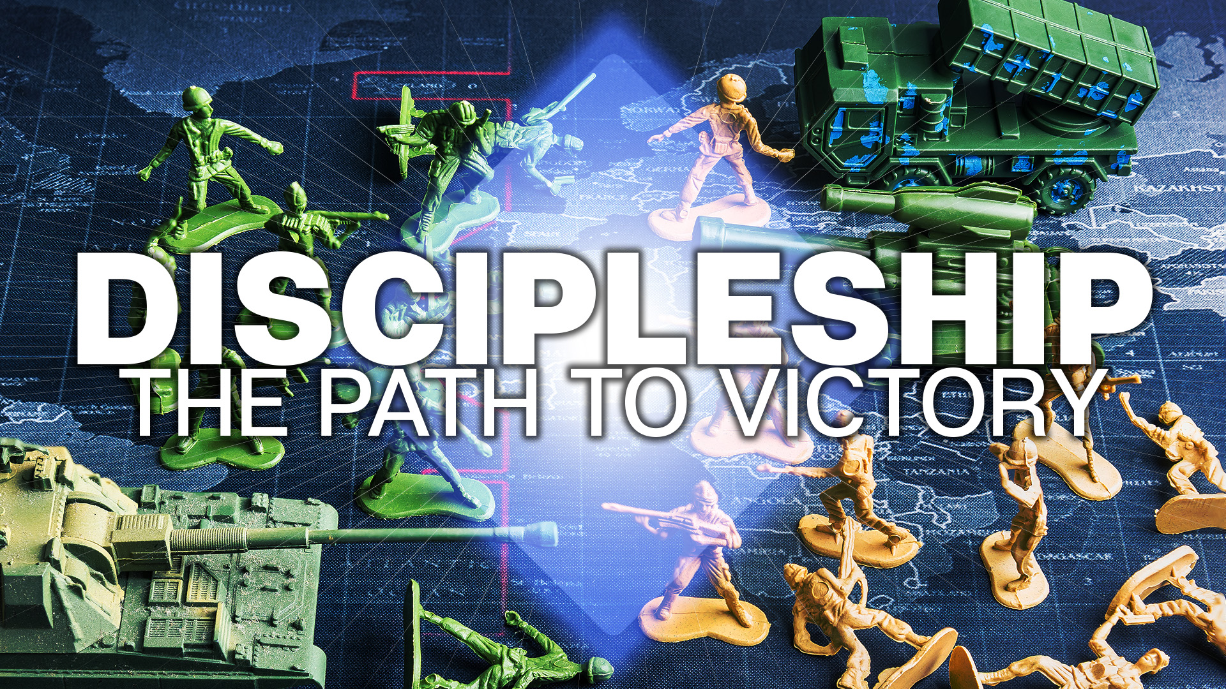

Slide 3
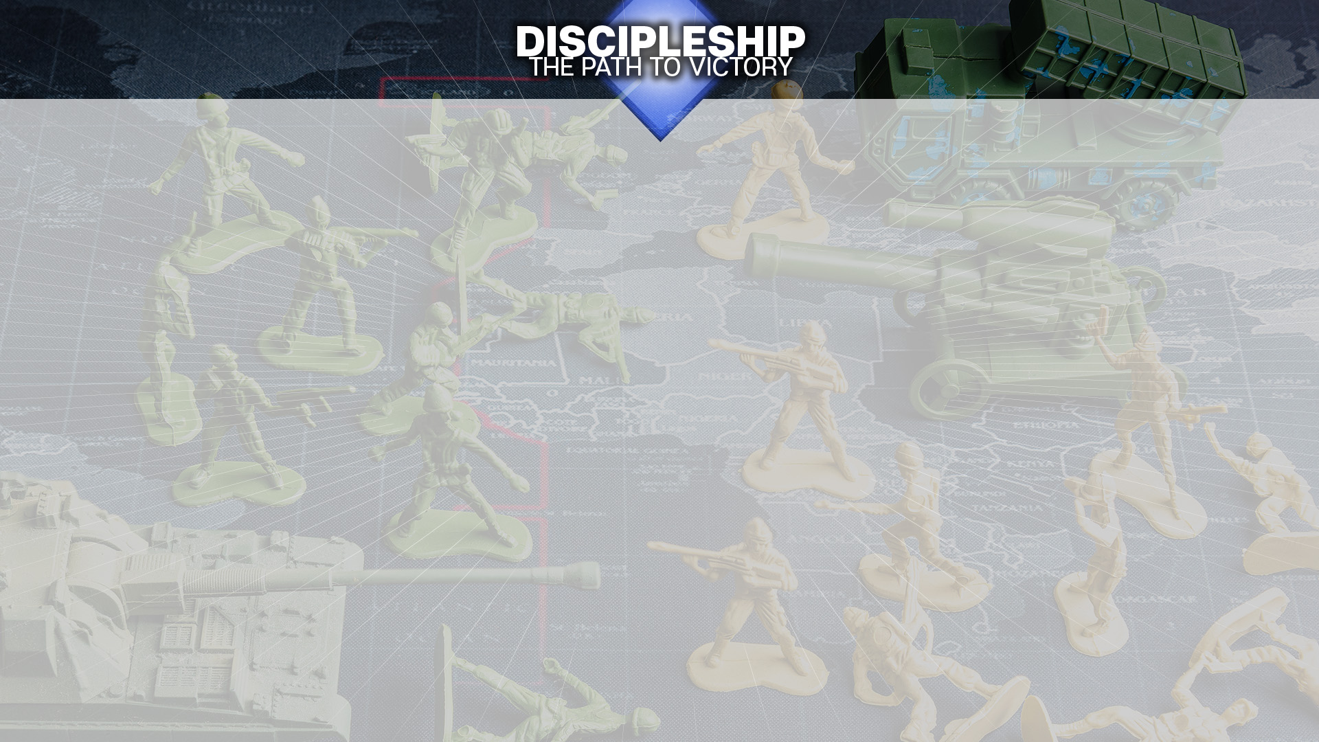
VICTORIOUS IN BATTLE
YOU WILL NOT CARRY OUT THE DESIRE OF THE FLESH
YOU CAN BE VICTORIOUS! YOU CAN OVERCOME!
THIS IMPLIES THAT YOU CAN NOT DO EVERYTHING YOU DESIRE

Slide 4
THERE IS A BATTLE!
DO YOU FEEL THE CONFLICT GOING ON?
THE FLESH AND THE SPIRIT WAR AGAINST ONE ANOTHER
YOU CAN’T SERVE BOTH!

Slide 5
YOU CAN BE FREE!
NOT THROUGH EXCEPTIONAL WILL POWER!
NOT THROUGH REMOVING EVERY TEMPTATION!
THROUGH THE SPIRIT WHICH LEADS YOU!

Slide 6
FINDING VICTORY!
FIGHTING THE BATTLE!
BEING TRANSFORMED BY THE POWER OF GOD!

