Slide 3
“Our Influences echo in eternity. The sunlight of that world will reveal my fingermarks in their primary formations and in all their successive strata of thought and life.”
Elihu Burritt
Notes:
Burritt was an American diplomat in the mid 1800’s

Slide 4
Matthew 5:13-16
Notes:
It’s a Rock!
Unusual qualities made it very valuable in human history
Shorthand for wealth – Ezra 4:14
Used as Currency
Roman military officers provided a salarium
“Betray the Salt”

Slide 5
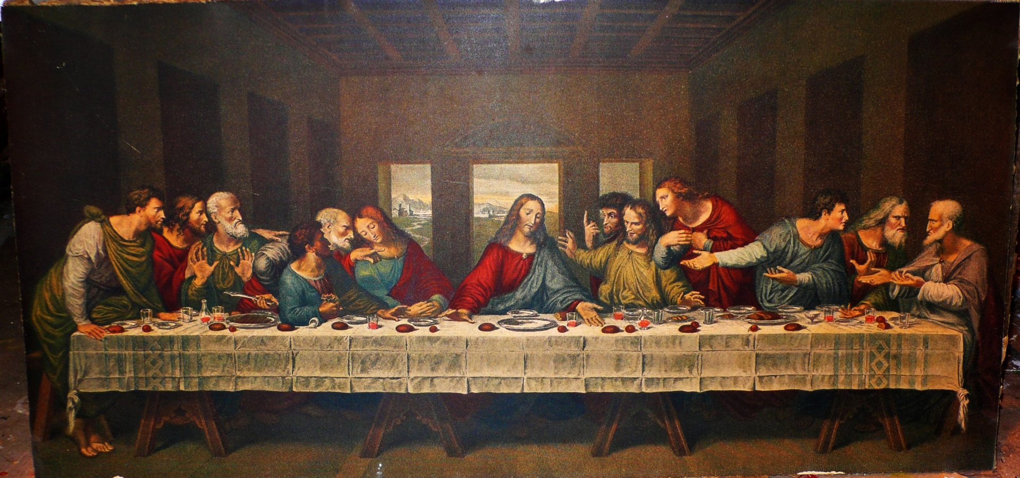

Slide 7
SEASONS
Salt overcomes blandness and makes food edible – Job 6:6
Christ had this trait in mind…
“…if salt has lost it’s taste…” (ESV)
How are disciples the “seasoning” of the world?
Col. 4:5-6
NASB – “…speech always be with grace, seasoned as though with salt…”

Slide 8
SEASONS
The Delicious Flavor of Grace
Eph. 4:29
The distinctive flavor of Jesus
Luke 4:22
What does this look like?
2 Tim. 2:24-25
Titus 3:1-3
Are we dispensing grace or ungrace?
What is the reaction to this seasoning?
I Peter 2:2-3

Slide 9
CAUSES THIRST
The impact of Salting!!
John 7:37
Grace-filled lives have an impact
1 Peter 2:12
Matthew 5:16
Philemon 4-6
Luke 14:34-35
Salt for the soil?
The End Result
I Peter 3:1-2

Slide 10
THE SALT CYCLE
Grace causes thirst
Jesus quenches thirst with grace
Showing grace salts others
Grace makes us salt source
Notes:
"You are the salt of the earth, but if salt has lost its taste, how shall its saltiness be restored? It is no longer good for anything except to be thrown out and trampled under people's feet.
(Mat 5:13 ESV)
Jesus answered her, "If you knew the gift of God, and who it is that is saying to you, 'Give me a drink,' you would have asked him, and he would have given you living water."
(Joh 4:10 ESV)
In the same way, let your light shine before others, so that they may see your good works and give glory to your Father who is in heaven.
(Mat 5:16 ESV)
1 – Taste the salt of grace
“Oh, taste and see that the Lord is good!” – Psalm 34:8
2 – Thirst for living water
“My soul thirsts for God, for the living God. When shall I come and appear before God?” – Psalm 42:2
3 – Become a salt source
“Have salt in yourselves, and be at peace with one another” – Mark 9:50

Slide 11
PRESERVES
Salt keeps meat from rotting
What impact do salty Christians have?
The world is rotting, what do we do?
Be realistic about the world – I John 5:19
Be realistic about our responsibility
Be optimistic about our influence
Pray – 1 Tim 2:1-2
John 17:15-17
Notes:
Realistic about the world – It IS rotting
Realistic about our responsibility – If the world is rotting, it is the fault of the salt
The salt does not have the right to mock the meat
without God, the world devolves into hatred, war, fear, anger
Optimistic about influence – ocean is about 3% salt
10 righteous people would have saved Sodom
John 17:15-17 – in the world – not “salt of the church”
not of the world – requires distinction – if the church divorces, lies, cheats, and fornicates at the same rate, we cannot be salt

Slide 12
INDESTRUCTIBLE
Salt crystals are extremely solid and durable
Only one way to make ineffective: Dilute!
Luke 8:7,14
Matt. 5:13

Slide 13
THE SALT CYCLE
Grace causes thirst
Jesus quenches thirst with grace
Showing grace salts others
Grace makes us salt source
Notes:
"You are the salt of the earth, but if salt has lost its taste, how shall its saltiness be restored? It is no longer good for anything except to be thrown out and trampled under people's feet.
(Mat 5:13 ESV)
Jesus answered her, "If you knew the gift of God, and who it is that is saying to you, 'Give me a drink,' you would have asked him, and he would have given you living water."
(Joh 4:10 ESV)
In the same way, let your light shine before others, so that they may see your good works and give glory to your Father who is in heaven.
(Mat 5:16 ESV)
1 – Taste the salt of grace
“Oh, taste and see that the Lord is good!” – Psalm 34:8
2 – Thirst for living water
“My soul thirsts for God, for the living God. When shall I come and appear before God?” – Psalm 42:2
3 – Become a salt source
“Have salt in yourselves, and be at peace with one another” – Mark 9:50

Slide 14
Grace causes thirst
Jesus quenches thirst with grace
Showing grace salts others
Grace makes us salt source
Turn, Embrace, Die to sin
Be Selfless
Learn, Trust, Love
Notes:
Salvation looks more like a cycle

