Slide 2
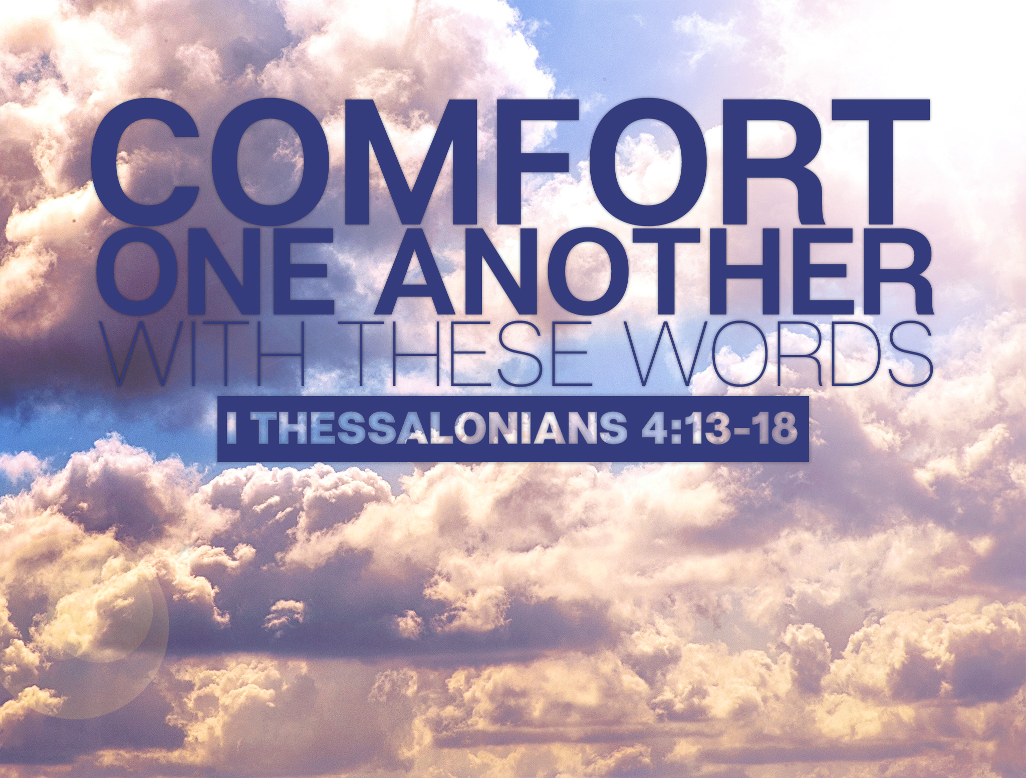

Slide 3

WHAT WAS THE PURPOSE OF THIS MESSAGE?
Written to faithful saints
In great affliction
Who were grieved by the loss of their brethren…
WE DO NOT WANT YOU TO BE “UNINFORMED”…

Slide 4
WHAT DID MOST THINK ABOUT LIFE AFTER DEATH?
Greco-Roman mythology reveals common belief that there was life after death.
  Acts 17:32 “when they heard of the resurrection…”
A griefless…joyless existence

Slide 5
HOW SHOULD CHRISTIANS THINK?
If God could bring Jesus back, why not you?
  I Thessalonians 4:14 “God will bring with Him…”
In I Corinthians 15 we learn Christ is the “first fruits”.
  Our resurrection will be like His.

Slide 6
HOW SHOULD CHRISTIANS THINK?
The future of those who rest in Christ…
  Shout…trumpet…the coming of a King!
The faithful dead will rest until the King returns.
  Then we will ALL go to meet Him…together!
“…we shall always be with the Lord”

