Slide 1


Slide 2

THE LETTER TO THE EPHESIANS
Written around 62 AD
Our central focus will be on Identity
Contains themes of God’s love
  1:5, 1:7, 2:4-5
But also our love as displayed through unity
  Church 4:11-13
  Family 5:22-6:4
  Moral Conduct 5:1-13

Slide 3
THE LETTER TO THE EPHESIANS
Revelation 2:1-7 addresses Ephesus church
  Disregarded teachers with no authority
  Committed to righteous thinking
  Suffered persecution
But had left first love (4)
  Possibly had left the love of God and the way they demonstrated that to others.

Slide 4
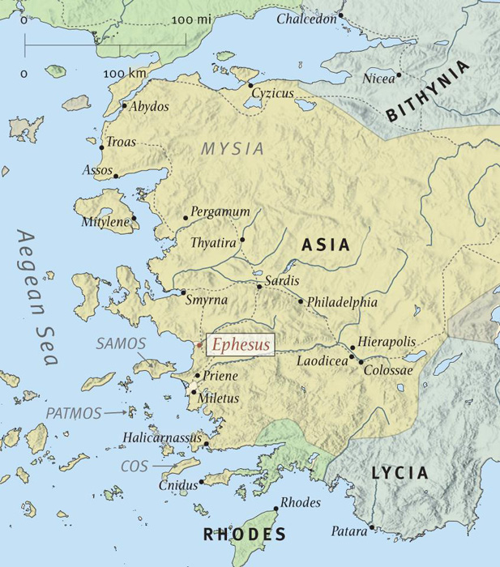
THE LETTER TO THE EPHESIANS

Slide 5
THE LETTER TO THE EPHESIANS
Wealthy city
Center of politics and religion
High population
Diverse beliefs
Lucrative business opportunities

Slide 6
CHRISTIAN, REMEMBER WHO YOU ARE
You are a SAINT
  G40 hagios – holy (Matthew 24:15)
  Set apart, called out
  Ephesians 4:1
You are FAITHFUL
  G4103 pistos – trusting, believing, persuaded
  Romans 1:17, Habakkuk 3:16-19

