Slide 2
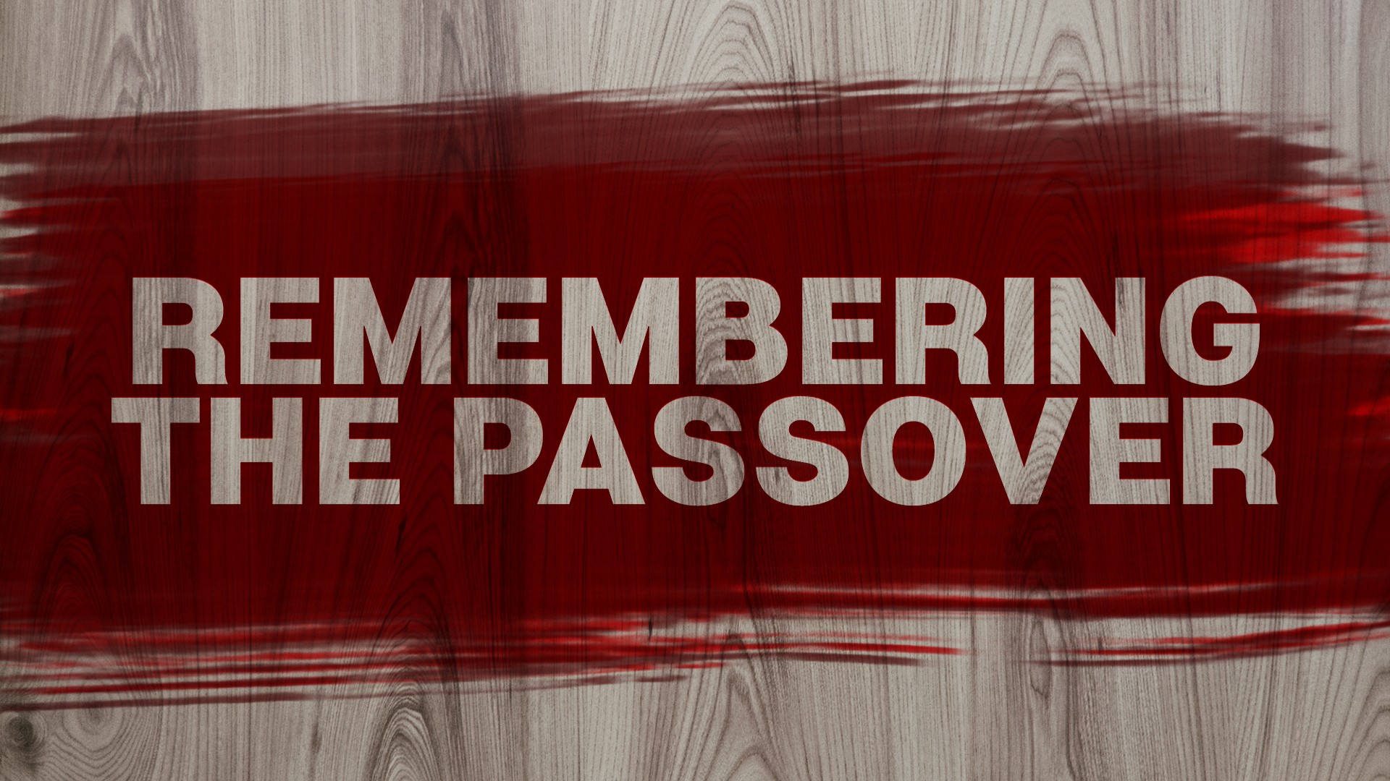

Slide 3

THE PASSOVER
EXODUS 12:11-14
God wants the people to remember WHO He is and WHAT He has done!
Saved them from slavery, leading them towards a new kingdom in their promised land!

Slide 4
THE BODY
Jesus refocuses on a new symbol…
  This Is My Body
  Mark 14:22 NIV “…Jesus took bread, and when He had given thanks, He broke it…”

Slide 5

I Corinthians 11:23-24
For I received from the Lord that which I also delivered to you: that the Lord Jesus on the same night in which He was betrayed took bread; and when He had given , He broke it and said, “Take, eat; this is My body which is broken for you; do this in remembrance of Me.
thanks

Slide 6
THE BODY
Jesus refocuses on a new symbol…
  This Is My Body
  Mark 14:22 NIV “…Jesus took bread, and when He had given thanks, He broke it…”
Jesus is the new Passover LAMB

Slide 7
THE BLOOD
Jesus continues by refocusing the cup
  “This is My blood of the new covenant which is shed for many.”
Blood represents life, covenants require blood!

Slide 8
Isaiah 53:12
Therefore, I will give him a portion among the great, and he will divide the spoils with the strong, because he poured out his life unto death, and was numbered with the transgressors. For he bore the sin of many and made intercession for the transgressors.

Slide 9
Exodus 24:6-8
And Moses took half of the blood and put it in basins, and half of the blood he threw against the altar. Then he took the Book of the Covenant and read it in the hearing of the people. And they said, “All that the LORD has spoken we will do, and we will be obedient.” And Moses took the blood and threw it on the people and said, “Behold the blood of the covenant that the LORD has made with you in accordance with all these words.”

Slide 10
THE BLOOD
Jesus continues by refocusing the cup
  “This is My blood of the new covenant which is shed for many.”
Blood represents life, covenants require blood!
Covenants also require love and commitment!

Slide 11
THE KINGDOM
Maybe most amazing part!
I am going to die, I will not partake any longer…
Until I drink of it new in the kingdom of God!

Slide 12
Isaiah 53:10
Yet it was the LORD’S will to crush him and cause him to suffer, and though the LORD makes his life an offering for sin, he will see his offspring and prolong his days, and the will of the LORD will prosper in his hand.

Slide 13
THE KINGDOM
Maybe the most amazing part!
I am going to die, I will not partake any longer…
Until I drink of it new in the kingdom of God!
  This is not the end for Christ!

Slide 14
THE HYMNS
Jews often sang during Passover.
Commonly, the Hallel psalms (113-118)
Think about these Psalms considering what Jesus was doing that day…
  Psalm 116

