Slide 2
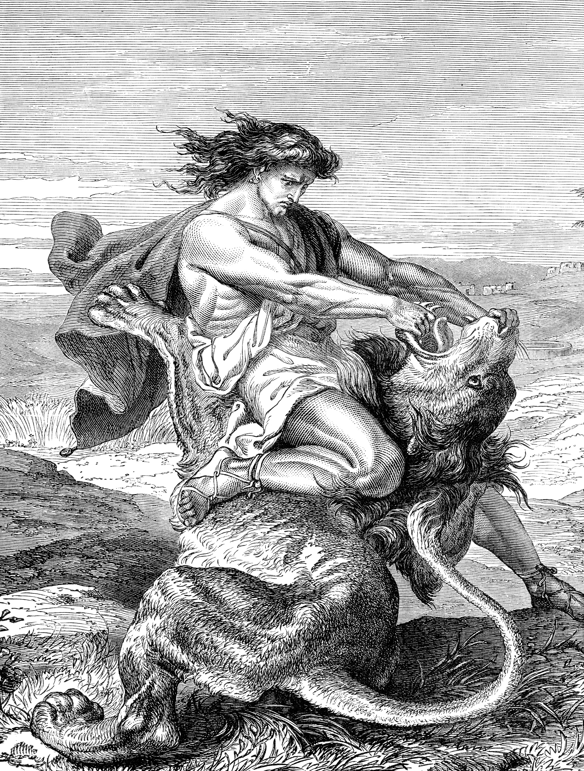
The Tragedy of Samson
Judges 13-16
A Nazarite
Nothing from grapes, no cutting hair, no touching corpses
First words - I saw a woman
Last words - I may… be avenged… for my two eyes
Lots of conflict
Dies defeating Israel’s enemies

Slide 3
Four Lessons from Samson
Samson reminds us of ourselves and our God.
Samson warns us of the dangers of lust.
Samson reveals the foolishness of vengeance
Samson shows us that God can use imperfect people to accomplish His will!

Slide 4
Similarities Between Samson and Jesus
Judges 15:12-13 bound and handed over to the enemy by their own people.
Judges 16:4-5 Betrayed by someone close to him
Judges 16:25 Enemies made amusement of him
Judges 16:29 He died with a pillar on his left and on his right
Judges 16:30 Through His death came deliverance.

