Slide 2
“
According to Christian teachers, the essential vice, the utmost evil, is Pride. Unchastity, anger, greed, drunkenness, and all that, are mere flea bites in comparison… Pride leads to every other vice: it is the complete anti-God state of mind…… it is Pride which has been the chief cause of misery in every nation and every family since the world began. ~C.S. Lewis
“

Slide 3
Consequences of SELF Worship
Anyone can be their own standard of truth
Your emotions become your scripture
YOU RULE
The individual becomes supreme
You become the Creator

Slide 4
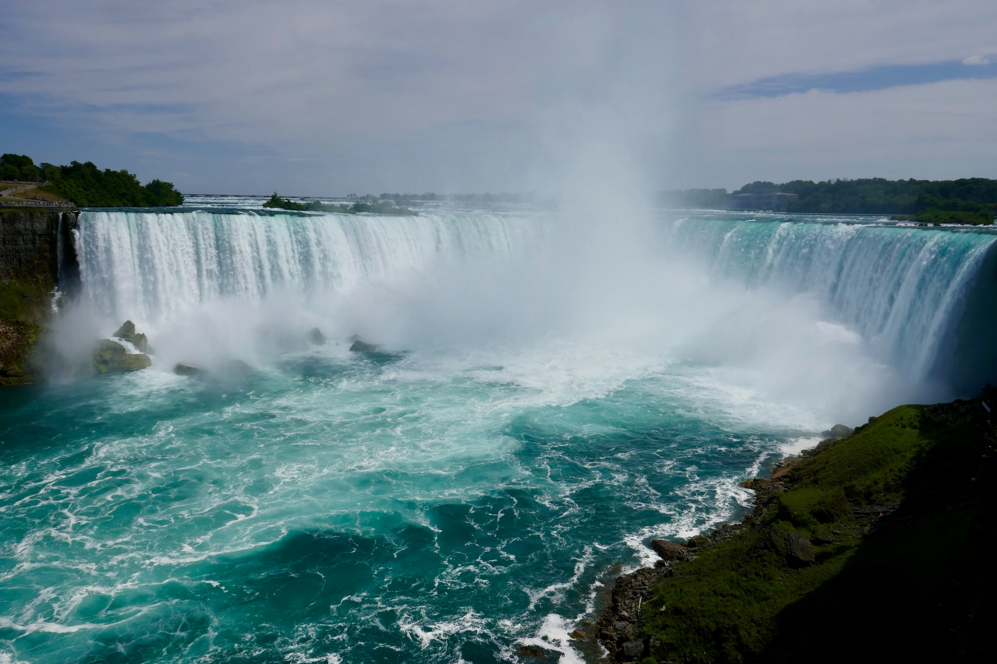
How does this EFFECT Christians?
It is sin! Direct rebellion against God!
It robs us of its promises

Slide 5
How does this EFFECT Christians?
“
…people felt smaller, and behaved in a more prosocial fashion… ~Paul Piff, UCI
Awe drastically improves cognition and substantially declines depression…
~Michelle Shiota, ASU
Psalm 89:7 NIV
In the council of the holy ones God is greatly feared; he is more awesome than all who surround him.
~Ethan, The Ezrahite
“

Slide 6
Taking a Stand
ACKNOWLEDGE your contribution
AMEND your focus
ADVENTURE forward in the AWE of God

