Slide 1
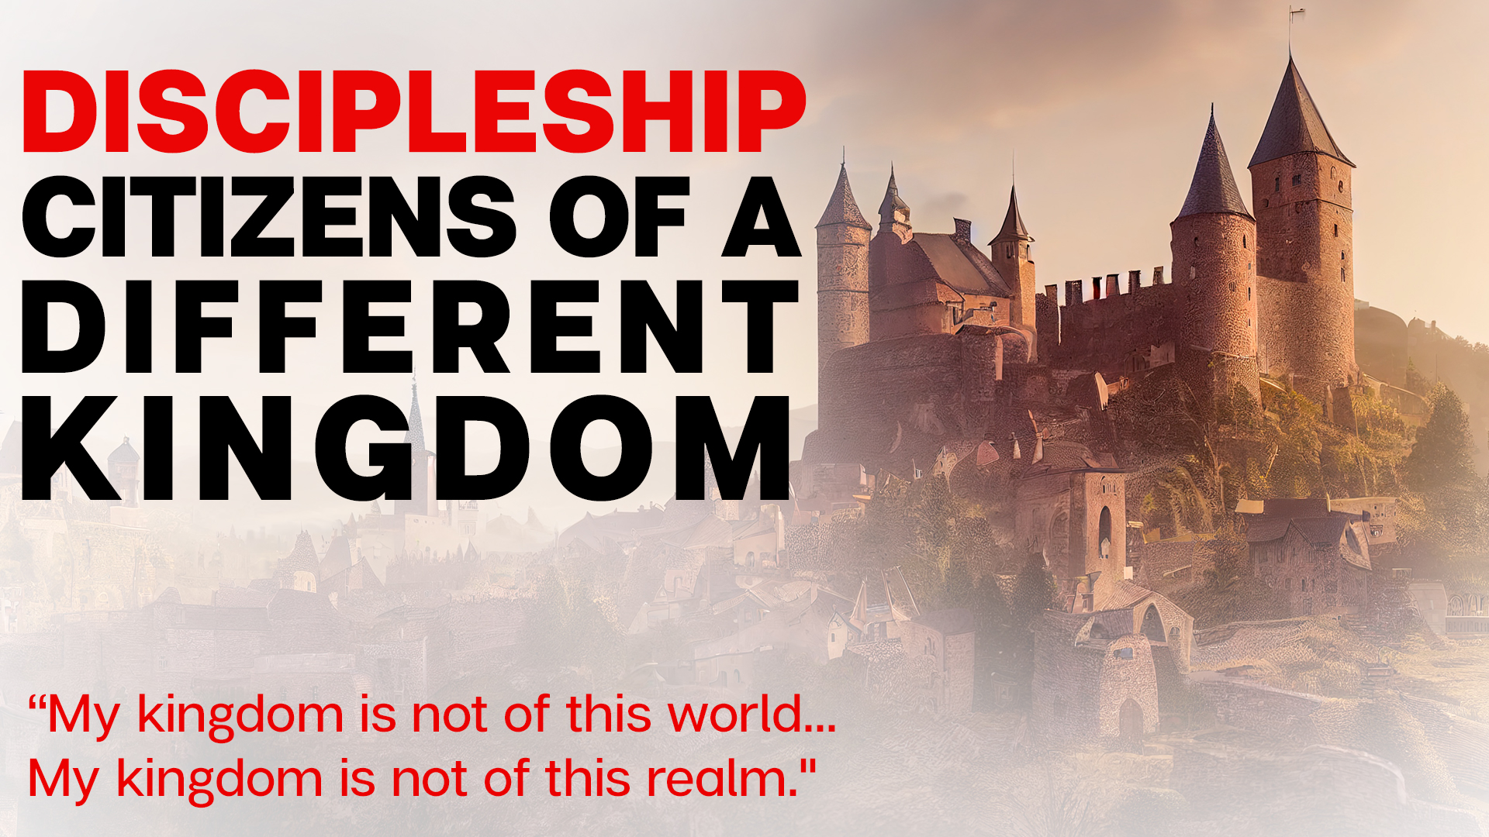

Slide 2
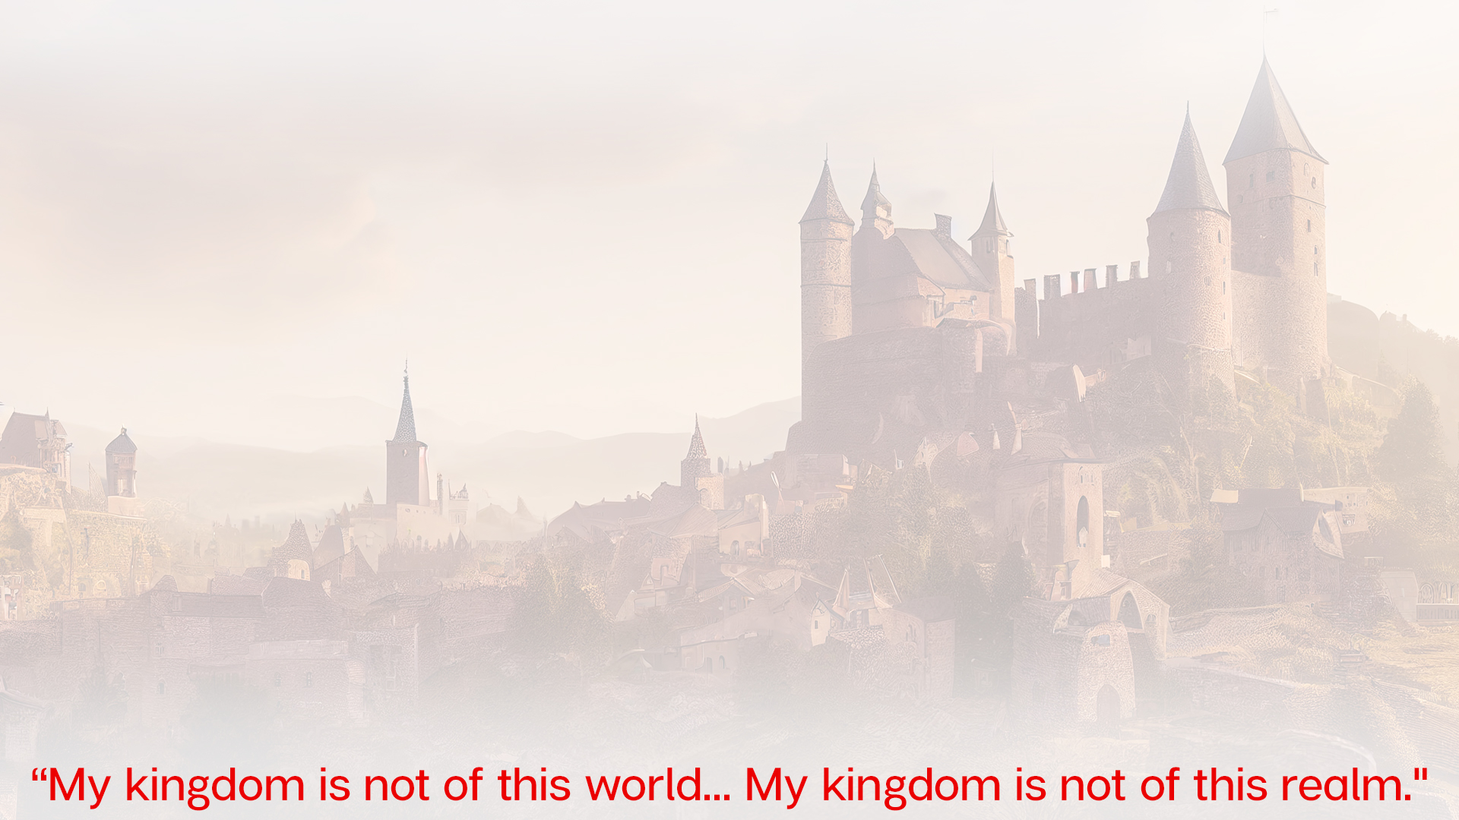
Last Teachings of Jesus
The church would be SEPARATE from the world – John 15:18-19
The church would be unconditionally loving – John 13:34-35
The church would have an obedient trust – John 14:1, 21

Slide 3
Sojourners: A People Not Of This World
Pagan Antagonist of Christianity
“They despise the temples as houses of the dead. They reject the gods. They laugh at sacred things. WRETCHED, the pity our priests. Half-naked themselves, they despise honors and purple robes. What incredible audacity and foolishness! They are not afraid of present torments, but they fear those that are uncertain and future. While they do no fear to die for the present, they fear to die after death!
…living in suspense and anxiety, you abstain from respectable pleasures. You do not attend sporting events. You have no interest in public amusements. You reject the public banquets, and abhor the sacred games… Thus, WRETCHED as you are, you will neither rise from the dead, nor enjoy life in the meanwhile. So, if you have any wisdom or sense, stop prying into the heavens and the destinies and secrets of the world….”
UNKNOWN AUTHOR
“They dwell in their own countries simply as sojourners… They are in the flesh, but they do not live after the flesh. They pass their days on earth, but they are citizens of heaven. They obey the prescribed laws, and at the same time, they surpass the laws by their lives. They love all men but are persecuted by all. They are unknown and condemned. They are put to death, but [will be] restored to life. They are poor, yet they make many rich. They possess few things; yet, they abound in all. They are dishonored, but in their very dishonor are glorified…. And those who hate them are unable to give any reason for their hatred.”
Justin Martyr, 2nd century evangelist
“Since our thoughts are not fixed on the present, we are not concerned when men put us to death. Death is a debt we must all pay anyway.”
Cyprian, an elder from Carthage
“The one peaceful and trustworthy tranquility, the one security that is solid, firm, and never changing, is this: for a man to withdraw from the distractions of this world, anchor himself to the firm ground of salvation, and lift his eyes from earth to heaven… He who is actually greater than the world can crave nothing, can desire nothing, from this world. How stable, how unshakable is that safeguard, how heavenly is the protection in its never-ending blessings – to be free from the snares of this entangling world, to be purged from the dregs of earth, and fitted for the light of eternal immortality.”

Slide 4
Servants: Loving Without Condition
Justin Martyr, 2nd century evangelist
“We who used to value the acquisition of wealth and possessions more than anything else now bring what we have into a common fund and share it with anyone who needs it. We used to hate and destroy one another and refused to associate with people of another race or country. Now, because of Christ, we live together with such people and pray for our enemies.”
Eusebius’s record of GREAT plague
An Actor & An Eldership
Ignatius
“Now note well those who hold heretical opinions about the grace of Jesus Christ that came to us; note how contrary they are to the mind of God. They have no concern for love, none for the widow, none for the orphan, none for the oppressed, none for the prisoner or the one released, none for the hungry or thirsty”

Slide 5
Sons and Daughters: With Childlike Trust
Felix, A Christian Lawyer
“God is greater than all our perceptions – He is infinite, immense. Only He truly understands His greatness; our hearts are too limited to really understand Him. We are making a worthy estimation of Him when we say that He is beyond estimation… Anyone who thinks he knows the magnitude of God, diminishes His greatness.”
Origen, 2nd Century Christian
“When God give the Tempter permission to persecute us, we suffer persecution. And when God wished us to be free from suffering, even though surrounded by a world that hates us, we enjoy a wonderful peace. We trust in the protection of the One who said, “be of good cheer, for I have overcome the world.’ And truly He has overcome the world. Therefore, the world prevails only as long as it is permitted to by Him who received power from the Father to overcome the world. From His victory we take courage. Even if He should again wish us to suffer and contend for our faith, let the enemy come against us. We will say to them, “I can do all things through Christ Jesus my Lord who strengthens me.’”
“Eventually, every form of worship will be destroyed except the religion of Christ, which alone will stand. In fact, it will one day triumph, for its teachings take hold of men’s minds more and more each day.”
Clement of Rome
“A person who does not do what God has commended shows he really does not believe God…”
Unknown Christian
“We don’t speak great things… we live them!”

