Slide 1
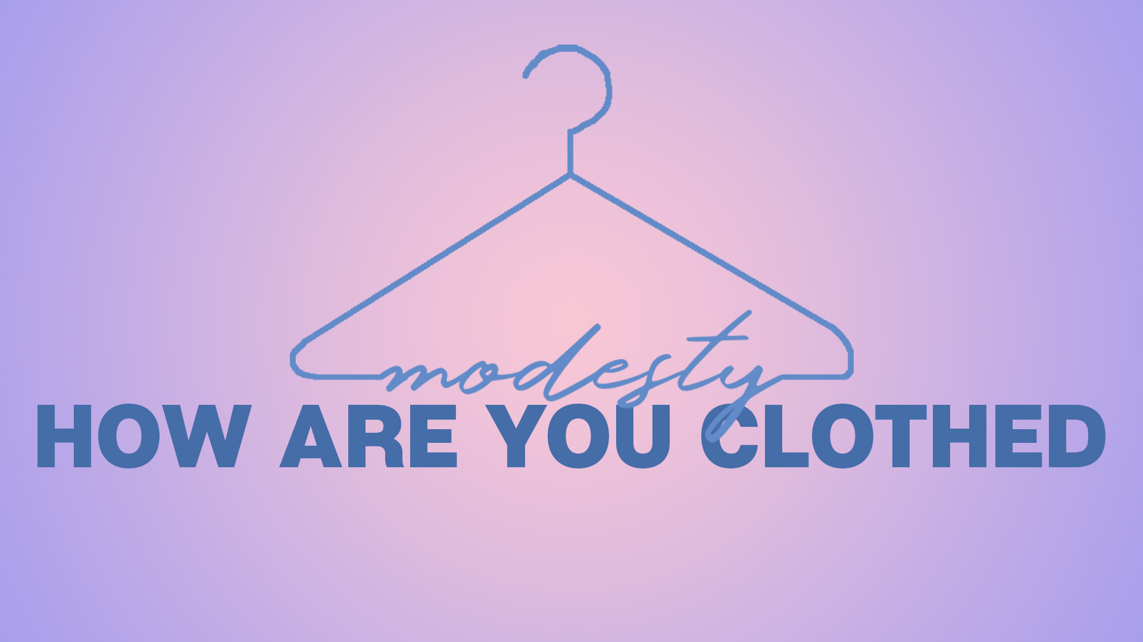

Slide 2
Is there a biblical pattern for public modesty for both men and women in the Bible, regardless of culture or situation?

Slide 3
IN THE BEGINNING
Genesis 3 Fall of Man
21 The LORD God made garments of skin for Adam and his wife, and clothed them.
Garments (Kutonet) tunic, under garment
Clothed them – to be fully clothed
7 “…made themselves loin coverings”
10 “…I was naked…”
God has authority on what is clothed
Is there a biblical pattern for public modesty for both men and women in the Bible, regardless of culture or situation?

Slide 4
MOSAIC LAW
Exodus 28:40-43
Priests need tunics (40)
Priests need breeches, cover loins-thighs (42)
God took this serious (43)
Exodus 20:25-26
Consider compromising situations
Is there a biblical pattern for public modesty for both men and women in the Bible, regardless of culture or situation?

Slide 5
UNDER CHRIST’S LAW
I TIMOTHY 2:9-10
Not-but Idiom
Proper clothing – well arranged, good behavior, respectful
Modestly – sense of shame, bashfulness, respect for others
Discreetly – self-control, self-restraint
Godliness – reverence towards God’s goodness, devoutness, and piety
Is there a biblical pattern for public modesty for both men and women in the Bible, regardless of culture or situation?

Slide 6
Is there a biblical pattern for public modesty for both men and women in the Bible, regardless of culture or situation?
YES
Titus 2
MAYBE
II Corinthians 10:31-33
NO
Hebrews 4:12

Slide 7
Galatians 3:27
For all of you who were baptized into Christ have clothed yourselves with Christ.

