Slide 2
We Become What We Worship
Old Testament Examples

Slide 3
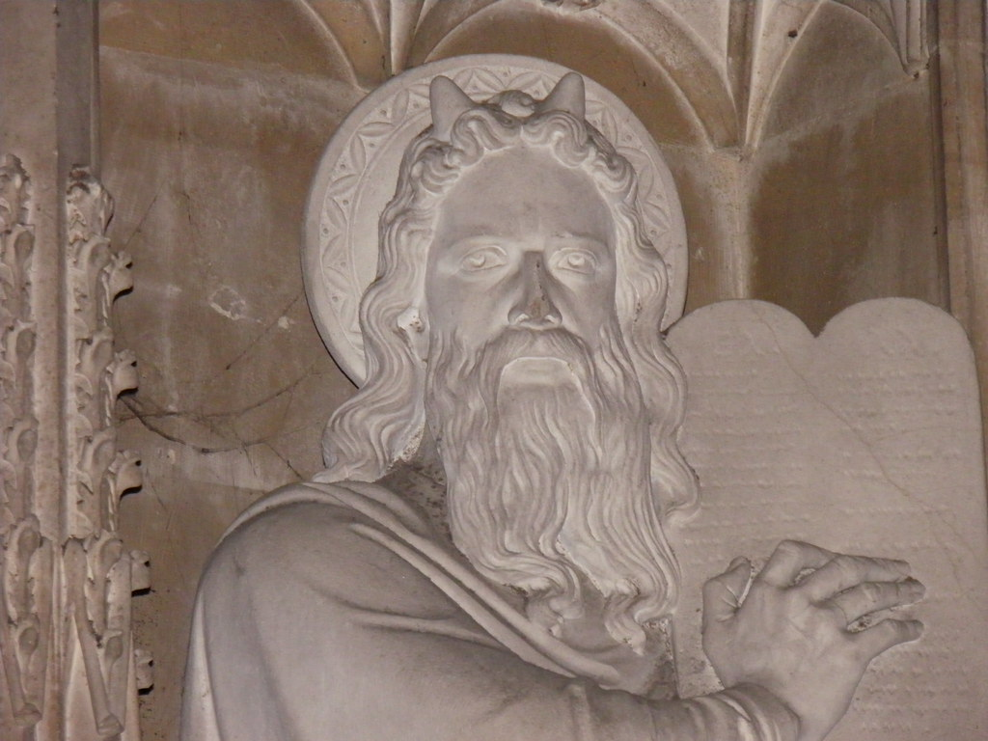
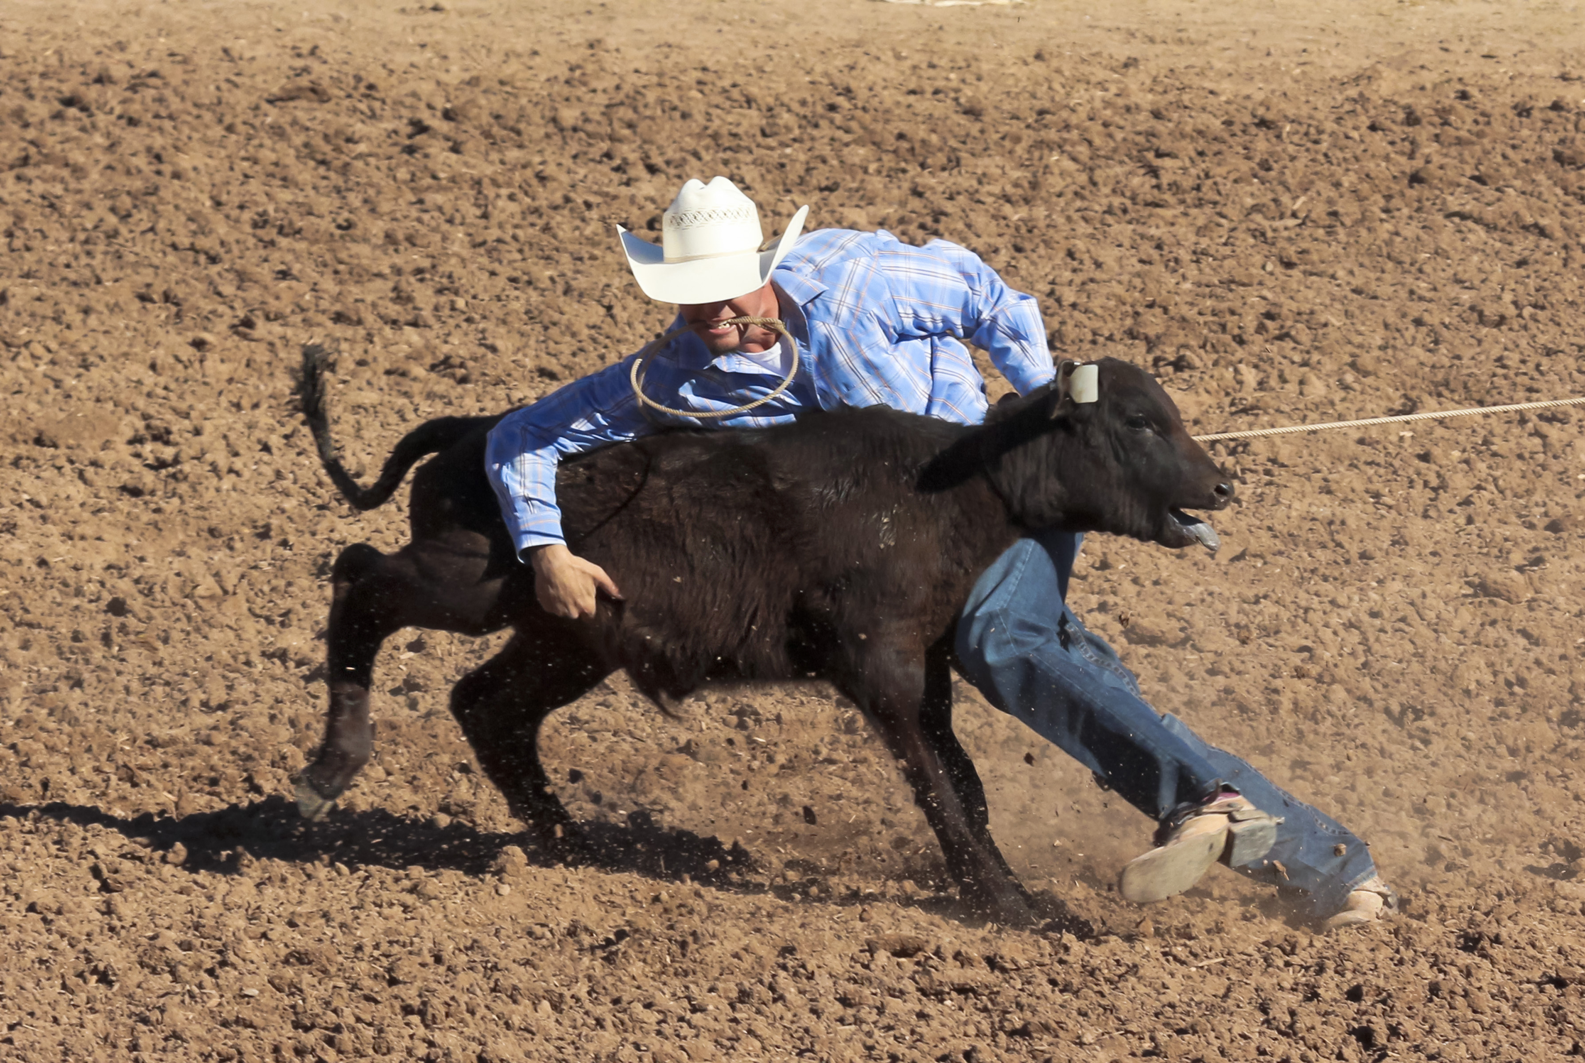
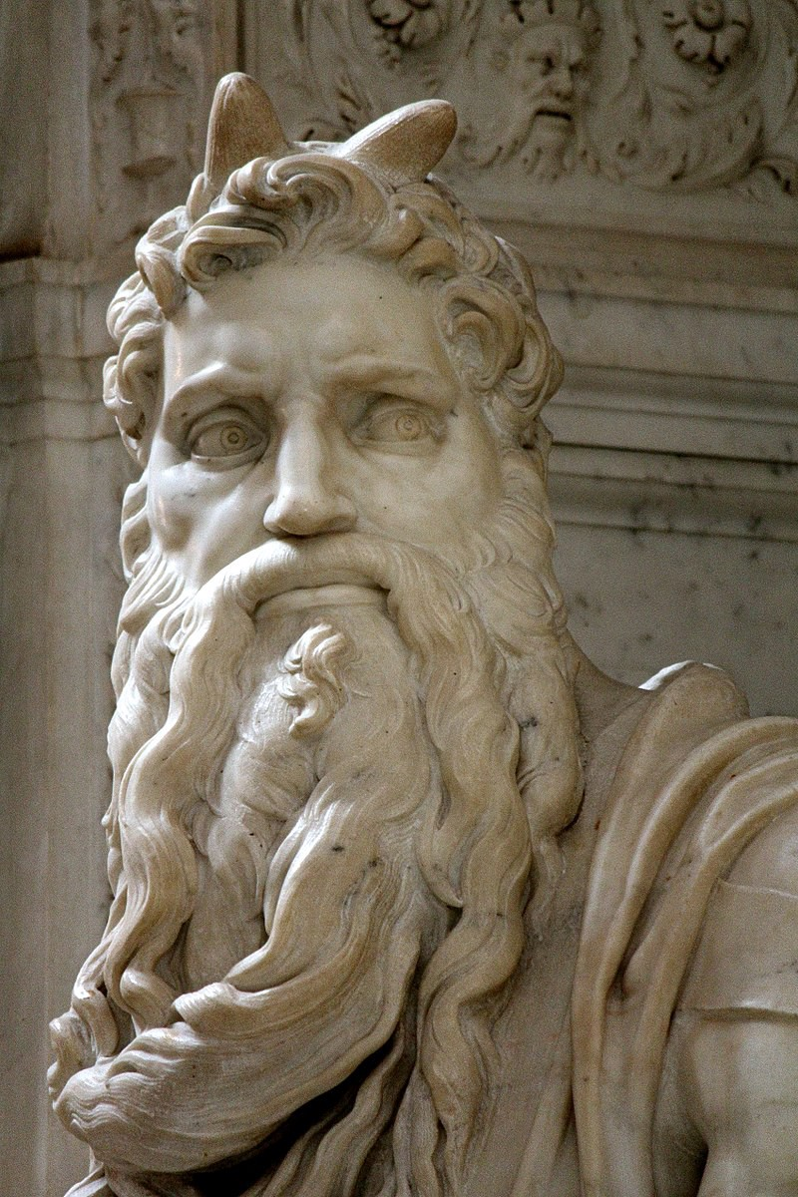
Reflections of Exodus 32-34 The Golden Calf Incident
Deuteronomy 29:4
"Yet to this day the LORD has not given you a heart to know, nor eyes to see, nor ears to hear.
Exodus 32:9; 33:3, 5; 34:9 Israel is obstinate
Exodus 32:25 Israel is out of control
Exodus 32:8 Israel is turned aside
Needs to be gathered together (32:26)
Exodus 34:29-25
The skin of his face shone
“his face was horned”

Slide 4
Reflections of Exodus 32-34 The Golden Calf Incident
Psalm 106:20
Thus, they exchanged their glory For the image of an ox that eats grass.
What is “their glory”?
The object of their worship
The reflection of the character and nature of God

Slide 5
Reflections of Exodus 32-34 The Golden Calf Incident
II Kings 17:14, 15
“However, they did not listen, but stiffened their neck like their fathers, who did not believe in the LORD their God… and they followed vanity and became vain…”
Retelling of I Kings 12 as a fundamental reason for the fall of Israel
Stiff-necked
Following vanity and become vain

Slide 6
Reflections of Exodus 32-34 The Golden Calf Incident
Hosea 4:16-17; 8:4-7; 13:2-3
Stubborn like a heifer… sow the wind and reap the whirlwind… they will become like dew, smoke, chaff…
Idolatry has had deep impacts in their spiritual life
Hosea 4:7 God says He will exchange their glory for shame

Slide 7
Reflections of Exodus 32-34 The Golden Calf Incident
Jeremiah 2:1-11
Judah had walked after emptiness and became empty… her priests prophesied and walked after profitless things… they had exchanged their glory for that which was profitless.
God’s inheritance has become and abomination!
Deut. 32:9 “Jacob is… His inheritance.”

Slide 8
We Become What We Worship
Old Testament Examples

Slide 9
We Become What We Worship
NEW Testament Examples
Ephesians 1:18
[I pray that you see]… the riches of the glory of His inheritance in the saints…

