Slide 1


Slide 2

Creating New Loyalties
Near Eastern cultures emphasize family connection
Forging new relationship
Focused on protection and defense of spouse

Slide 3
Joined, United, Glued
This is a permanent relationship
You are vowing to uphold this bond

Slide 4
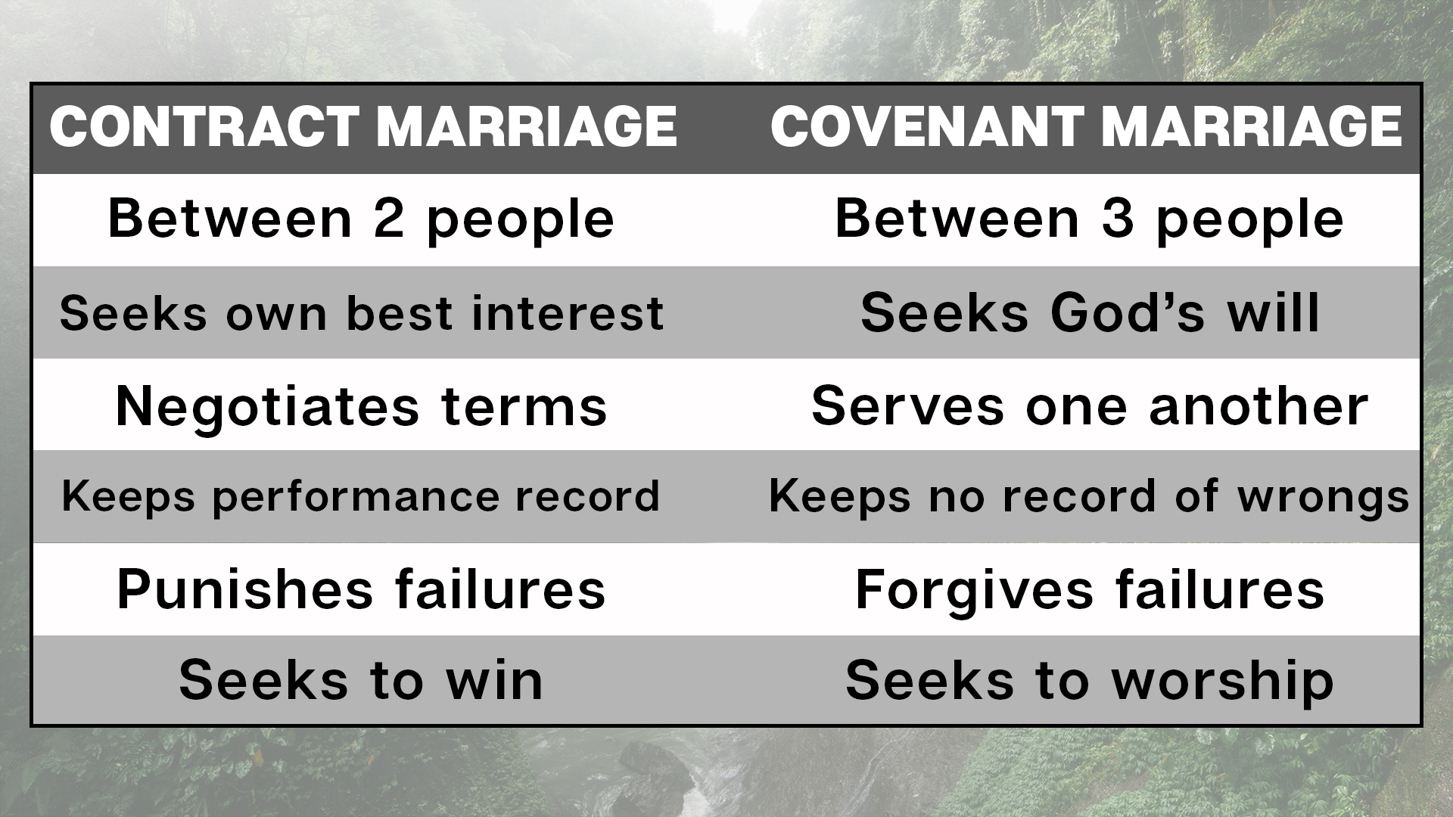

Slide 5
Joined, United, Glued
This is a permanent relationship
You are vowing to uphold this bond
Malachi 2:10-14
  Covenant: even when I don’t get what I desire
  Covenant: reflecting God’s love

Slide 6
Two Becoming One
We are ONE
  Fighting, attacking, belittling; it hurts us both!
We are UNITED
  Given to one another by one another.
We are UNASHAMED
  No exploitation, nothing to hide, no fear.

Slide 7
A Covenant Example
1 Peter 3:1-7
Wives be submissive
  This is an open declaration to the world. I am submitted to God.
  This is a MAJOR decision, choose wisely!
Husbands be understanding
  You live recognizing her decision to trust you with her life.
  Honor this!

